Slide 1
Flight Price Prediction
Submitted by
Juhi Mishra - 28/11/21

Slide 2

Problem Statement and Understanding
Here I do have to predict the flight price which may vary depending upon various factors. As we all know that flight price fluctuates a lot. Price depends upon how early the ticket been taken and for which time period. Like if any special occasion is there flight price even after 2 months will be higher compare to other days. And if tickets been taken 2 or 3 days back or on the same day price will be too high. Most of the time we see that same day ticket price will be too high, similarly 10 days prior or before that compare to same day price will be low. And if someone taken almost a month back , flight ticket will be at cheapest cost. But as per the business point of view if ticket been taken on an urgent or few days back , then the profit will be good , as for same flight where one passenger taken at say for an example rs.2000, and on an urgency one taken at 10000 so profit on 10000 will be more compare to 2000. Considering this situation most of the aviation house they hold some seats for an emergency purpose so that last minute rate will be high and they will earn good profit . Few special occasion state wise also price of flight tickets generally higher . Even weekend tickets too are comparatively higher . So depending upon consideration where they can earn good profit and will get customer easily target most and keep the price high intentionally.

Slide 3

Explanatory Detailed Analysis - EDA
To have good model very first thing as a data scientist we need to analyse our model properly. Means what are the steps we need to follow. One very important step is to have proper data cleaning. If data cleaning not done in proper way then it will affect our model performance. Here in this dataset there were no null values which I checked using info and isna method. So no need to do anything for missing values. Next using info method checked what datatype do this dataset have , accordingly will perform. Here we were having only one numerical column which was target column means price, And there were one date column which was in date time format. Rest all were in object datatype. As we know that our machine algorithm doesn’t understand string datatype so to convert the same to numerical datatype we need to apply encoding technique. Here I used one hot encoder as my columns were less so chances were less to have huge number of columns which is possible if I do have lot many variables in one particular column as one hot encoder generally increases the number of columns. Here Data, Arrival, Departure,Duration, these columns using date time method converted to numerical columns. So only for source, destination and flight I used one hot encoder . Due to which my number of columns from 9 increased to 28. For total stop used replace method as the data inside that were less. After data cleaning and preprocessing done checked relation among features using correlation method. As if there is high correlation among feature then are chances of overfitting as both the features may share same relation which our model can learn twice and predict accordingly. So to avoid such situation generally we use few techniques and remove such columns which will show high correlation among them just to avoid overfitting. Here there were no such columns. So not removed any of the column except site column which was not required for our prediction purpose. Removed date, Arrival, Departure columns as already extracted data from there.

Slide 4
Visualisation Analysis

Slide 5
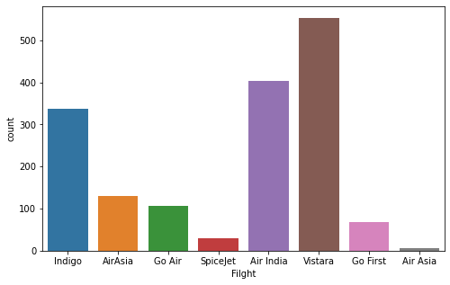
No of Flight Analysis
Above using countplot analysed which flight are more in number. Vistara followed by Air India which is ruined by government is more in number compare to all other flights and Air Asia is the which is having very less flights available . In economical flights we can see that indigo is more in number. Even Air Asia too are considered as economical flight only as the price these flights are cheaper depending upon time and distance.

Slide 6
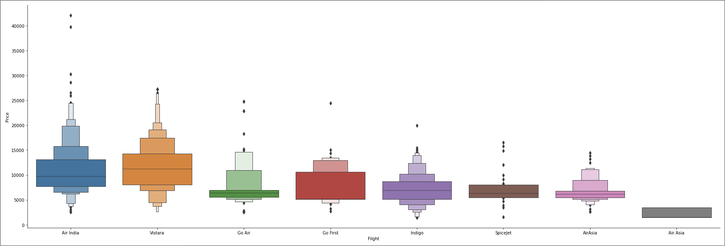
Flight vs Price Analysis
Here using catplot trying to get the insight of which is cheaper and which flight do have higher price. Vistara do have higher price compare to all other flights while Air India too shows higher rate only . By plot we can see that there are minor difference between vistara and Air India. Here we can say that these two flights generally targets business class customers. While rest all are having economical price. They target all type of customers especially Indigo and Go Air do have cheaper price depending upon distance and time.

Slide 7
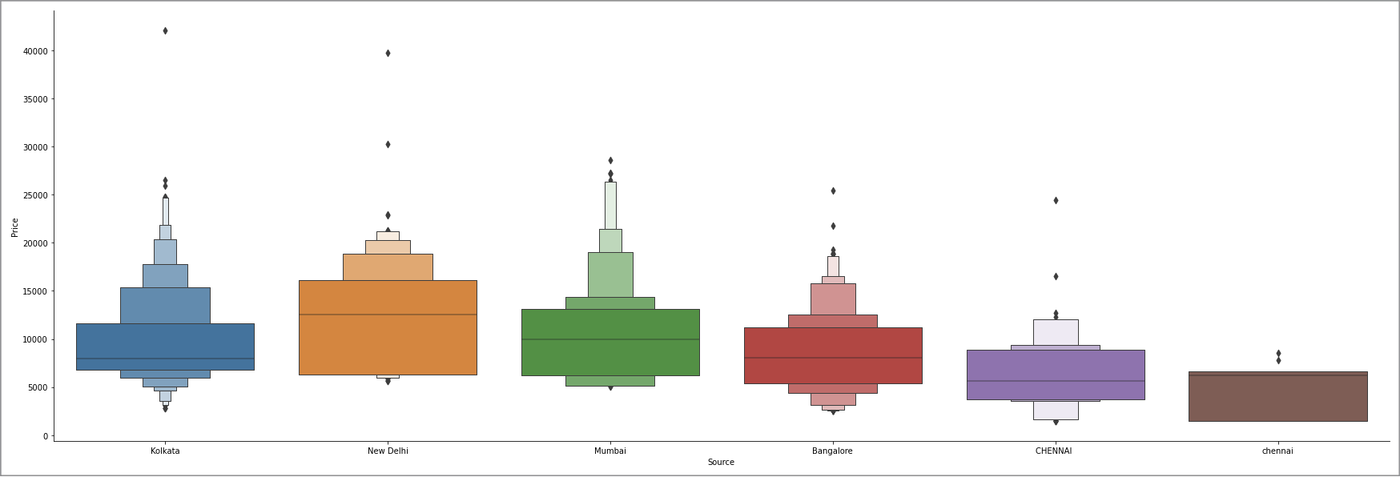
Source vs Price Analysis
Source means from where the customer takes flight. Here New Delhi we can see are having higher price compare to any other city . As I am analysing few of the metropolitan cities like Kolkata, New Delhi, Mumbai, Bangalore and Chennai. Among all New Delhi having higher price for any of the flight and lowest is for Chennai.

Slide 8
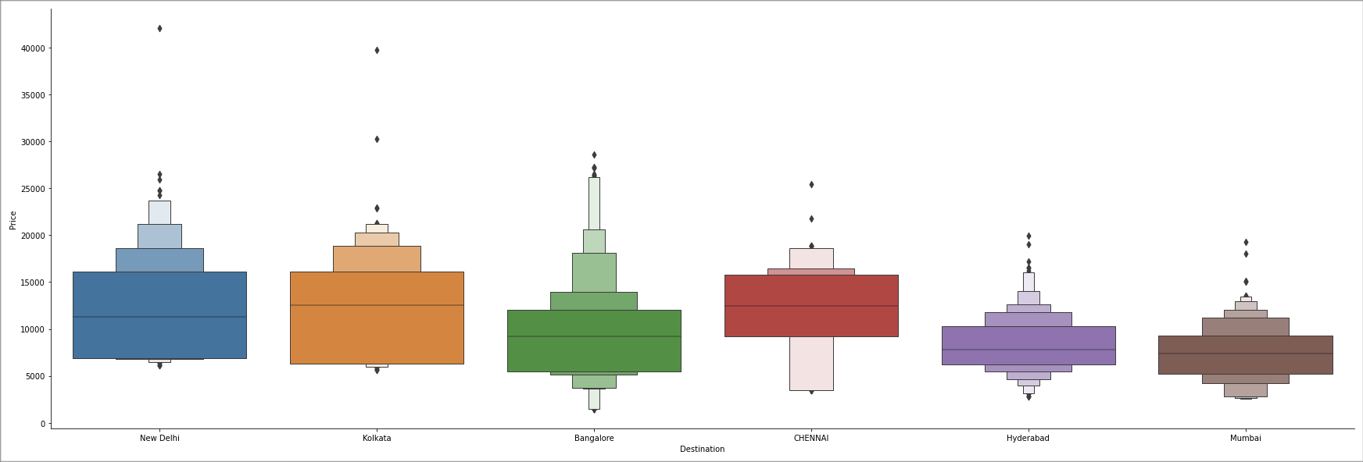
Destination vs Price Analysis
Destination here means where customer wants to go means final destination. Again for New Delhi we can see having higher price likewise in source we observed. Even Kolkata too have higher flight rate compare to any other city.

Slide 9
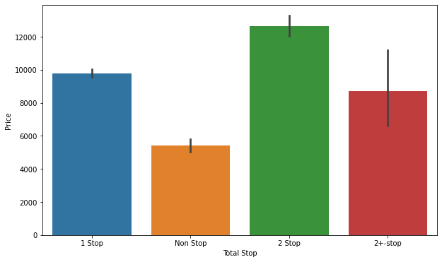
Total Stop vs Price Analysis
For more stoppage price of flight is high. Likewise above using barplot we can see that flight which is having 2 stop is having higher price followed by 2+ stop.. And the cheapest we can see is for non stop flights as these flights covers less distance . And for less distance it’s obvious that price will be less as distance coverage is less and fuel consumption even are too less.

Slide 11
As this dataset was related to flight price prediction so first I thought was what type of dataset is his means regression or classification based problem. But when I gone through the PDF provided by Flip Robo came across that we need to predict the price of flight which is always considered as continuous column and continuous columns are considered to be regression problem. Based on which I decided which model to run for this problem statement. Few protocols which we generally follow is removing null values, skewness , outliers etc, here no such operations were required as there were no null values so no treatment required for the same. Moreover skewness and outliers generally we perform for continuous columns means its a kind of mathematical operation but here none of the column were continuous column. It’s not mandatory that all the columns which are in numerical form they are continuous, Generally mathematical operation we perform for those where predicting between two continuous value is difficult means the data is continue in nature . While there are few numerical columns which are considered to be discrete column where we can assume what next can come as non other possibility between will take place. Also few model which I assumed will perform best for this dataset , but they were not turned so good as per expectation, so tried few other algorithms so that will get best model and prediction will be more accurate.

Slide 12


Slide 13
As this was Regression based problem statement so used model accordingly which were regression models. For this problem statement below listed models I used for prediction purpose:
1. Linear Regression
2. Decision Tree Regression
3. Random Forest Regression
4. Lasso
5. Ridge

Slide 14
Linear Regression
lr = LinearRegression()
lr.fit(x_train,y_train)
pred = lr.predict(x_test)
print(r2_score(y_test,pred))
Score = 51%
print(cross_val_score(lr,x_scaler,y,cv=5).mean())
Score = -6.99
About using linear regression model tried to get the prediction for flight price. Here R2 score is 51% which is not so good and Cv score is in negative which means this model doesn’t performed as expected

Slide 15
Decision Tree Regression
Decision Tree score as get here is even bad from linear Regression there I was having R2 score as 51% while in dt model R2 score is only 39% while CV score is also in negative. Which means both the model performance were not at all good for this problem statement.
dt = DecisionTreeRegressor()
dt.fit(x_train,y_train)
pred = dt.predict(x_test)
print(r2_score(y_test,pred))
Score = 39%
print(cross_val_score(dt,x_scaler,y,cv=5).mean())
Score = -1.13

Slide 16
Random Forest Regression
rf = RandomForestRegressor()
rf.fit(x_train,y_train)
pred = rf.predict(x_test)
print(r2_score(y_test,pred))
Score = 73.8%
print(cross_val_score(rf,x_scaler,y,cv=5).mean())
Score = -0.47%
Here comparing all other model Random Forest Regression is having higher score which is 73.8% but Cv score is in negative. Still considering metrics score Random Forest Regression is the best performing model.

Slide 17
Lasso and Ridge CV score
Lasso and Ridge generally we use when we need to check whether the model is overfitted or not. Below is the score for Lasso and Ridge.
lassocv = LassoCV(alphas = None, max_iter=1000, normalize = True)
lassocv.fit(x_train,y_train)
alpha = lassocv.alpha_
lasso_reg = Lasso(alpha)
lasso_reg.fit(x_train,y_train)
lasso_reg.score(x_test,y_test)
Score = 51.14%
ridgecv = RidgeCV(alphas =(0.1,1.0,10.0),normalize = True)
ridgecv.fit(x_train,y_train)
alpha = ridgecv.alpha_
ridge_reg = Ridge(alpha)
ridge_reg.fit(x_train,y_train)
ridge_reg.score(x_test,y_test)
Score = 51.14%
Above we can see that both ridge and lasso score is same and they both are similar to Linear Regression whose score was 51%. Which means model is not overfitting

Slide 18
MAE, MSE, RMSE Metrices to check Error
from sklearn import metrics
print('MAE:', metrics.mean_absolute_error(y_test, pred))
print('MSE:', metrics.mean_squared_error(y_test, pred))
print('RMSE:', np.sqrt(metrics.mean_squared_error(y_test, pred)))
MAE : 1401.065
MSE : 4886091.63
RMSE : 2210.45
Here the score shows that having higher error value in this dataset . Mean squared error means even the score will be in negative but score will always shown as positive because all scores get squared same for root mean squared error here only difference is score get smaller as we root the score.

Slide 19
Hyperparameter Tuning
Hyperparameter tuning generally we do to improve the score . Here I used GridSearchCV for tuning the model on best performing model.Here best performing model is Random Forest Classifier. Below is the snapshot of Hyperparamater Tuning done :
RandomForestRegressor
param = {'n_estimators':[30,40,50,60],
'criterion':['mse','mae'],
'max_depth':[2,3,4,5,6],
‘max_features':['auto','sqrt','log2']}
GC = GridSearchCV(rf,param,cv=5)
GC.fit(x_train,y_train)
GC.best_params_
final_rfc = RandomForestRegressor(criterion = 'mse',max_depth = 6, max_features = 'auto',n_estimators = 50)
final_rfc.fit(x_train,y_train)
pred = final_rfc.predict(x_test)
metrics.r2_score(y_test,pred)
Score = 63.29%

Slide 20
Conclusion
This dataset is all about flight price prediction where as a data scientist I need to predict the price of flight depending upon previous price dataset. Flight price depends upon various factors like destination i.e.,source and final destination, arrival and departure time, duration, total stop. If the total stop increases flight price go high as the distance increases . Even arrival time matters a lot means usually we observed that early morning and late night flights are more cheaper than usual day and evening flights. Also to earn more profits generally aviation house do hold few of the seats for last minute sale. As last minute tickets are generally sold at very high price where any of the flight will have good profit. So reserving seat is one of the technique which most of the aviation house do to earn more profit and increase their revenue. Here in this dataset after loading it to python checked the shape of data . Where total no of rows were 1632 and 9 columns. After getting data started data cleaning and preprocessing. Data cleaning is one of the important aspect for best model building. First started with whether there is any missing values or not . There were no missing value in this dataset. Next checked the type of data. There were most of the columns which were in string datatype. So to convert them to numerical form used encoding method. Encoding method generally converts object datatype to numerical form. Here I used one hot encoder to convert few of the object columns like flight, source and destination. Rest date, arrival, departure and duration column using date time method converted them to numerical form. And for total stop used replace method. Once feature engineering done checked the correlation among feature to avoid overfitting. But there were very less correlation among any feature. Not dropped any of the feature. As the number of feature be more model performance will be much better. Then splitting feature and target into x and y respectively for model building. Scales all the feature using standard scaler to bring them to same unit. Next find best random state based on which trained the model. After finding best random state selected few of the algorithms for model building . These are - Decision Tree Regression, Random Forest Regression, Linear Regression, Lasso and Ridge. Among all Random Forest Regression were the best performing model with R2 score of 72%. But CV score was in negative for all the models. So checked using other metrics like MAE,MSE,RMSE error score. And the error was too high. Next to improve the model score used GridSearchCV for hyperparameter tuning. There also score not improved. Instead of increase score get reduced. This may be possible because of I had to add more parameters so that model could have trained themselves more better or could have performed more algorithms based on which would have done hyperparameter tuning.

